Slide 1

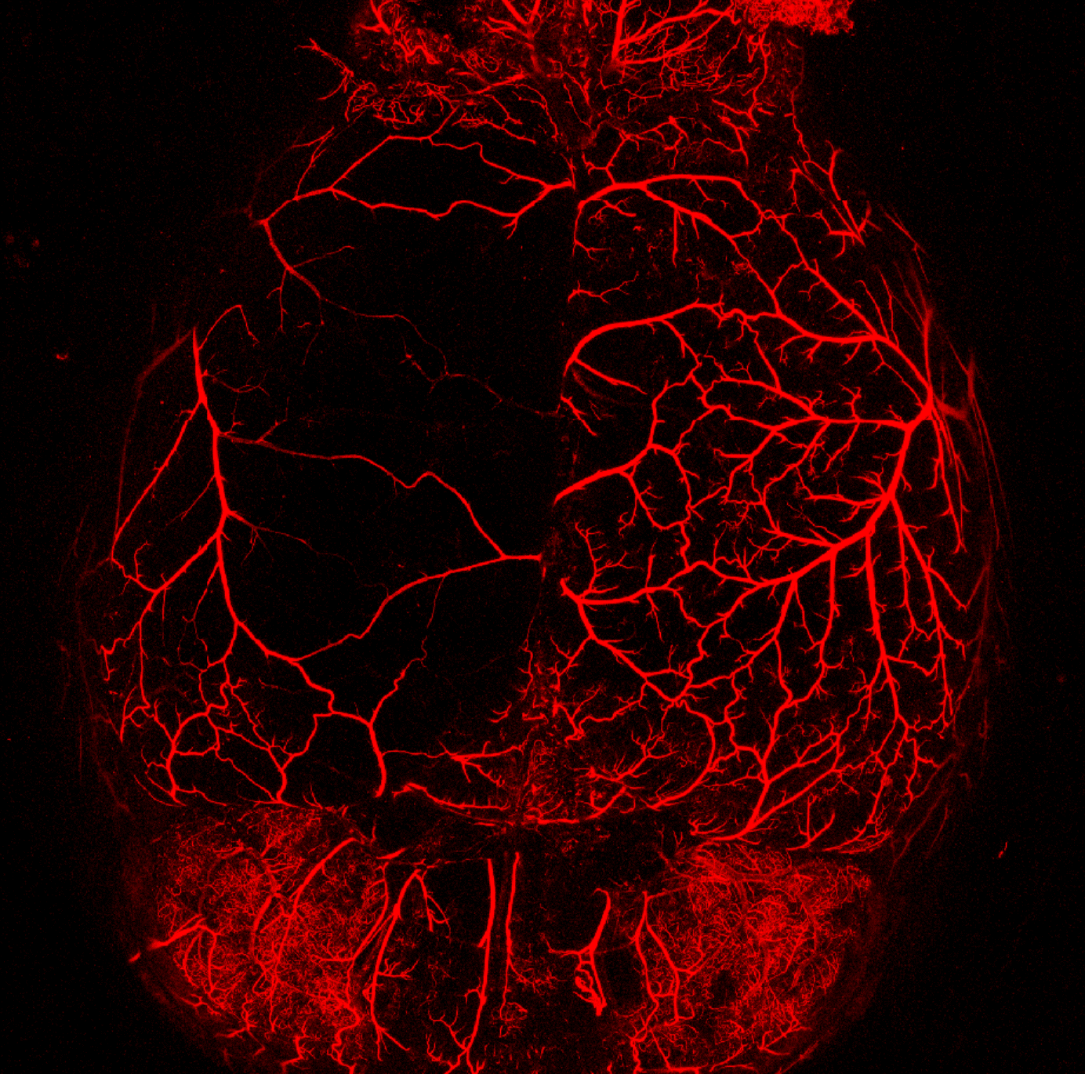
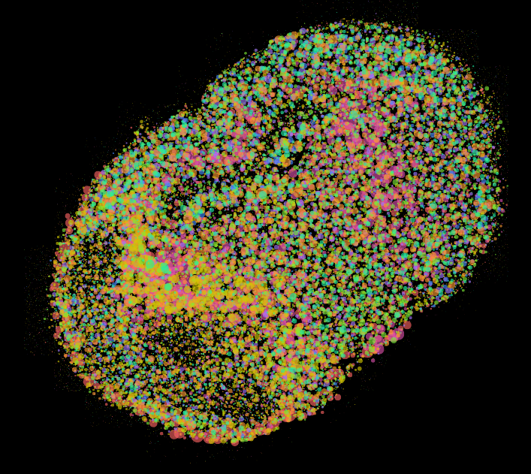
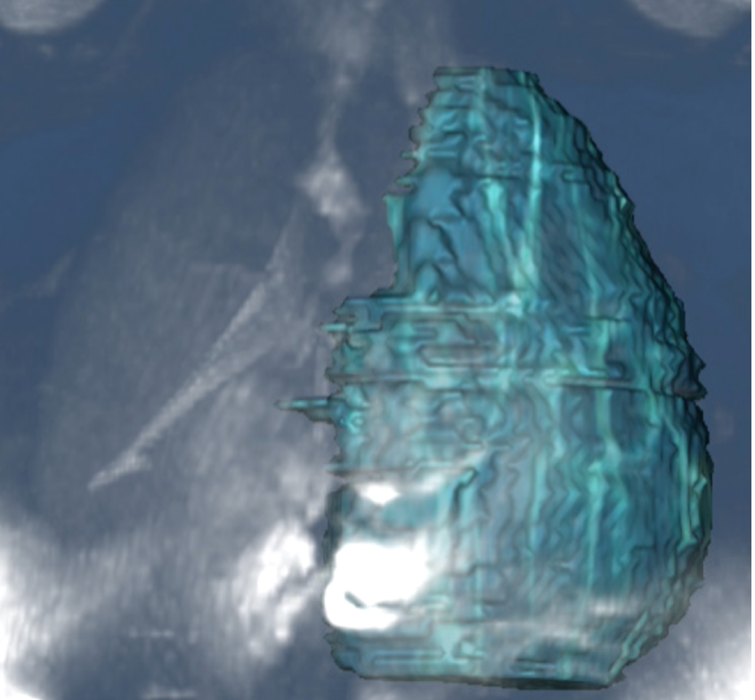
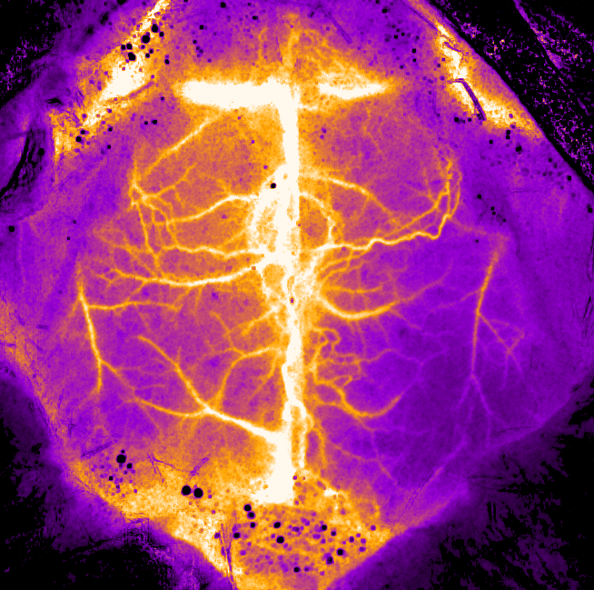
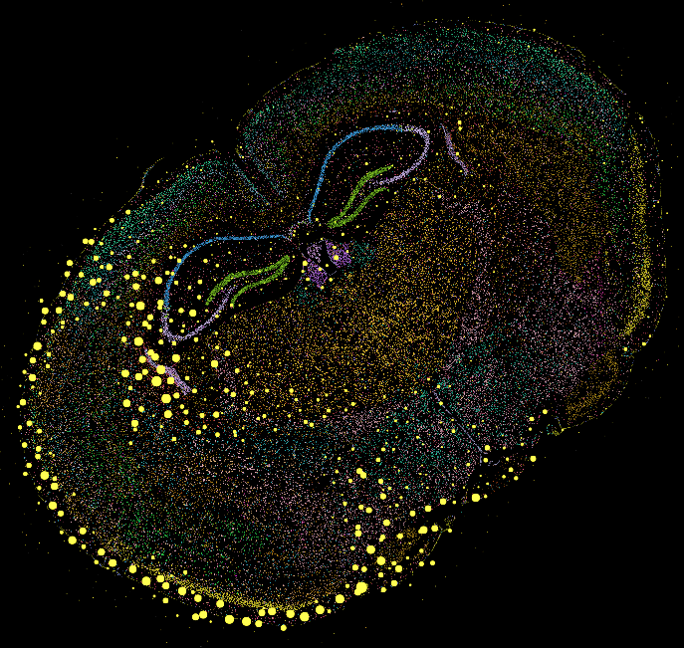
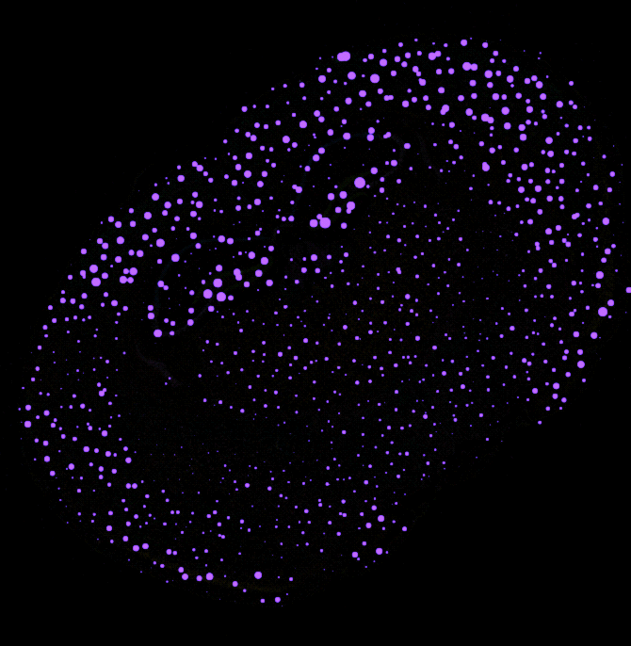
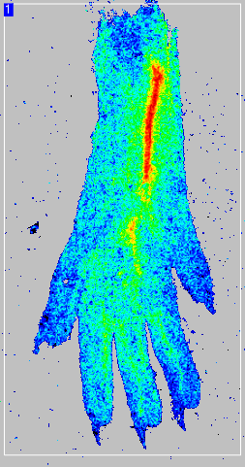
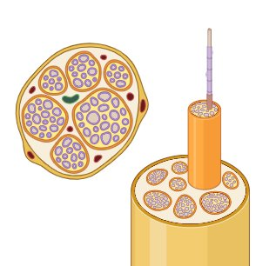

Development of Mechanism-Based Therapies
Brain injury (Stroke) Cerebral collaterals & their role in rescue against acute ischemic stroke in diabetic mice
MCA-ACA collateral zone
contralateral
Transcripts
MCA
ACA
MCA
Ipsilateral
contralateral
Vessel painted mouse brain – Dil. Perfusion
Ipsilateral
Savita Khanna
Gfap
NeuN
Diabetic peripheral neuropathy (DPN): Neurotrophic skin reprogramming to rescue DPN
Glial scar
Ischemia
Behavioral Characterization of
Stroke effects
LSI Image- perfusion
3D MRI - Infarction
Spatial Transcriptomics - Xenium
TNT based reprogramming
Intraepidermal nerve density
Behavioral Characterization of
Somatosensation
Characterization of nerve myelination
Spatial Proteomics – Phenocycler fusion

